Slide 1
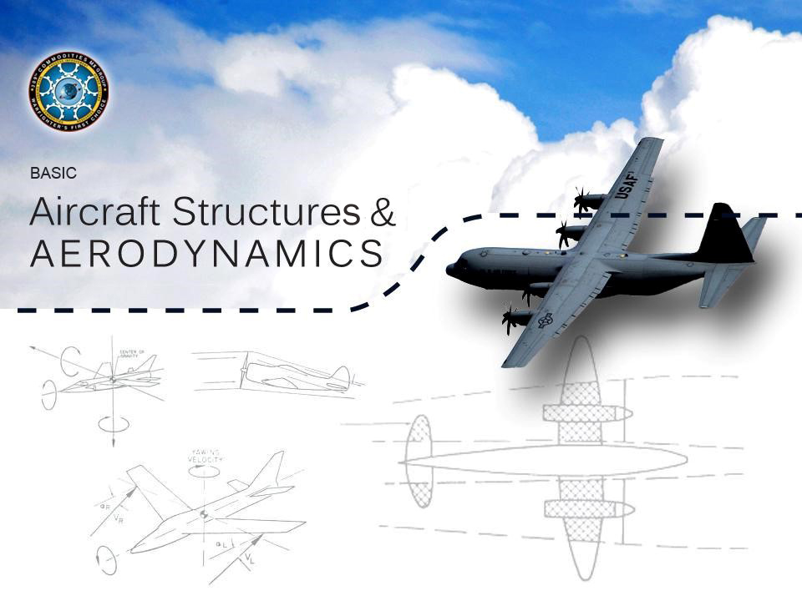
Notes:
*The code at the top of the slide is to help you keep track of where you are in the presentation. S=Slide number, C=Click number*
Welcome the students to the class. Inform the class of the course name and explain why we are here.
Tell the class how long the course is expected to last (about 5 hours) and at the end of the course, students are released back to the work centers. Provide student with the information applicable to the building the class is being conducted in.
Beverages and snacks are/are not allowed in the classroom. Using the cell phone in class is a distraction, to include texting. Please turn off or silence your cell phones while in class. In case of fire, bomb threat, evacuation exercise, or other emergency, the class will go -------. We will meet up at ------------.
Throughout this course, you should utilize any stories you have heard or experienced that help to add substance to the things being talked about. Encourage students to share stories they may have as well.
Emphasize as much as possible throughout the course the human factor involved in each of their jobs. People fly on aircraft, and when one goes down for whatever reason, it very often kills all on board. Even if you don’t know anyone personally that travels on military aircraft, chances are they fly over your house on a continuous basis. A catastrophic failure could endanger residents on the flight path of an aircraft. These are things for the student to reflect on as the topics in this course are discussed. Each has a personal and professional responsibility to ensure parts are manufactured and handled correctly.

Slide 2
Welcome!
Student Responsibilities
Course Completion Criteria
Student Critique Program
Emergency Evacuation
Restroom Locations
Breaks
Smoking area
Notes:
Welcome students and ensure they’ve all signed the attendance roster.
Students have a responsibility to get everything out of this class they can and give maximum participation.
Students should take notes on anything they like or don’t like about this class to later put it into a critique to help improve this course.
Discuss emergency evacuation plans/routes and relocation area.

Slide 3
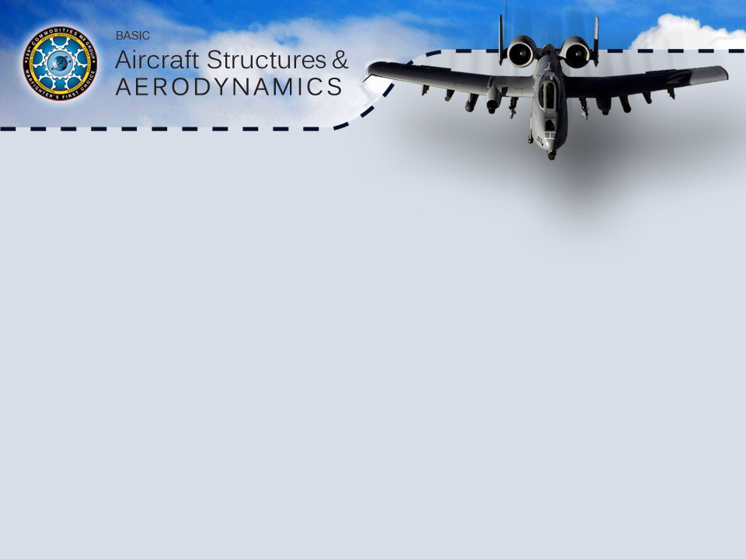
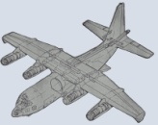
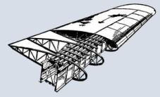
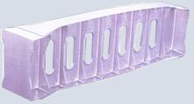
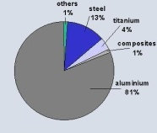

Course Introduction and Overview
Aircraft Flight Dynamics
Basic Aircraft Structures
Aircraft Components Loading
Various Aircraft Materials
Corrosion Control
3
Notes:
Give a quick overview of the course by briefly explaining each of the 5 units included in the course.
Introduction to Aircraft Flight Dynamics will discuss some basic aircraft flight characteristics.
Basic aircraft structures will introduce you to the basic structures of an aircraft.
The aircraft components loading section will discuss specifics about the loads that parts are under in flight.
The main purpose of this course is to give the students an appreciation and understanding of how an aircraft flies and the stresses that it is under as it does so. As part of that, we touch on why aircraft are designed the way they are to help students understand that every component on an aircraft is flexing and moving during flight, and that the integrity of each individual component is important for the overall structural integrity of the aircraft. We will also discuss the various types of materials used in aircraft construction and why we use different ones and also how to control corrosion that can be caused between these materials. It is important to tailor this information to the jobs that each student performs to help them understand how crucial it is that they perform their duties correctly because it does affect the end product- the completed aircraft.

Slide 4
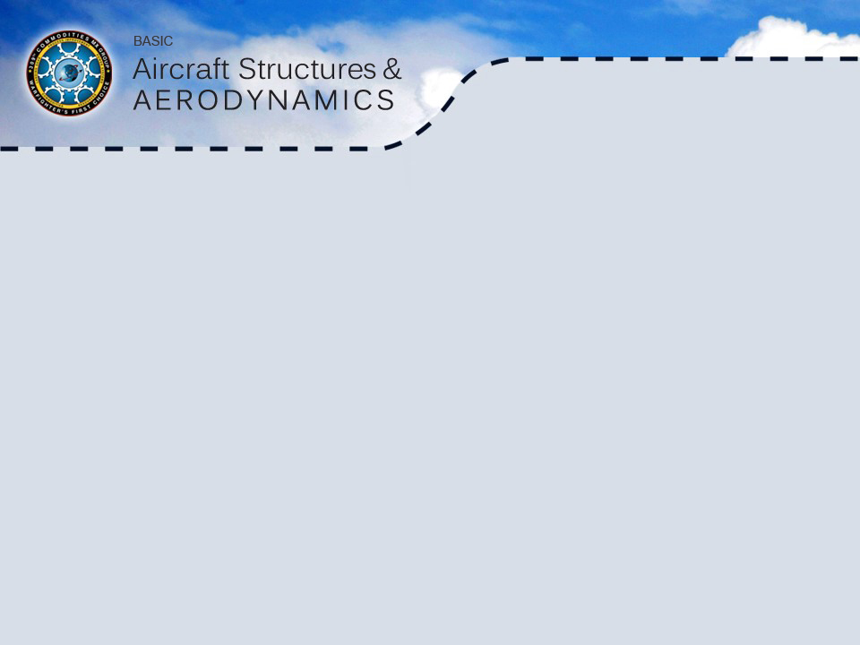
Aircraft Flight Dynamics
Aircraft Flight Dynamics Overview
Lift of a Wing
Stall of a Wing
Symmetrical Wing
Flight Control
Stability
Flight Loads
Supersonic and Subsonic Differences
Notes:
Explain that these are the sections that will be covered in Unit 1.
Explain that it is important to understand how and why an airplane flies first so that the later units about stresses and loads will make more sense to them.

Slide 5

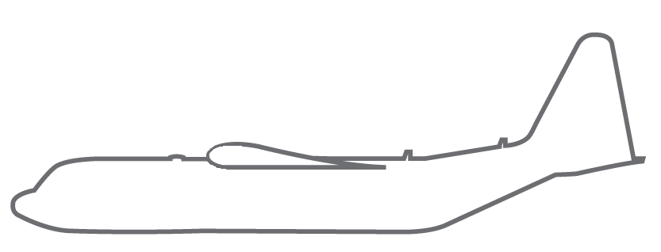
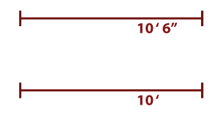


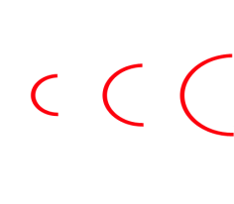


Aircraft Flight Dynamics (cont.)
Lift of a Wing
Bernoulli’s Principle:
As velocity increases, pressure decreases.
Laminar Flow
&
Aerodynamic Smoothing
5
Notes:
*The code at the top of the slide is to help you keep track of where you are in the presentation. S=Slide number, C=Click number*
Discuss the design and shape of the wing and how it generates lift as a result.
1st click- Tell the students that as the wing moves forward, the air flows over the top of the wing, and an area of stagnant air is created forward of the wing that causes the air to separate in front of the wing’s leading edge
2nd click- and over the bottom of the wing creating a slight downwash as it does so.
3rd click- Because of the way a wing is designed, the distance air travels over the top of the wing is further than the distance it travels on the bottom of the wing, causing the air to move faster over the top of the wing.
4th click- Discuss how the air molecules on the top of the wing are spread apart because the same amount of molecules are passing by, but at a quicker rate.
5th click- Discuss the equivalent molecule spacing on the bottom of the wing- Explain Bernoulli's principle- as velocity increases, pressure decreases. The molecules are closer together on the bottom of the wing because they are travelling more slowly and this causes the air to be more dense on the bottom of the wing than on the top (more pressure). Because the air is traveling more quickly on the top of the wing, a negative pressure is created there…
6th click- and this creates lift. The negative pressure being created on the wing in straight and level flight is shown in the lift diagram with three arrows. In essence, the wing is pushing down on the air to lift the plane. As the wing changes attitude in the air, so does the lift being created on it. As the wing tilts upward into the air, it creates a greater lift because the air travels even further over the top of the wing. Changing the shape of the wing by using flaps and slats also increases the lift generated by the wing by forcing the air to travel further over the top.
Laminar Flow refers to those air molecules right on the surfaces of the wing that are not travelling along the top and bottom of the wing, but are causing friction right on the wing surface.
Aerodynamic smoothing is what we do to the surface of our wing to try and cut down as much as we can on laminar flow. These are things such as making screw heads on the skin and other components in various other areas flush with the aerodynamic surface.

Slide 6
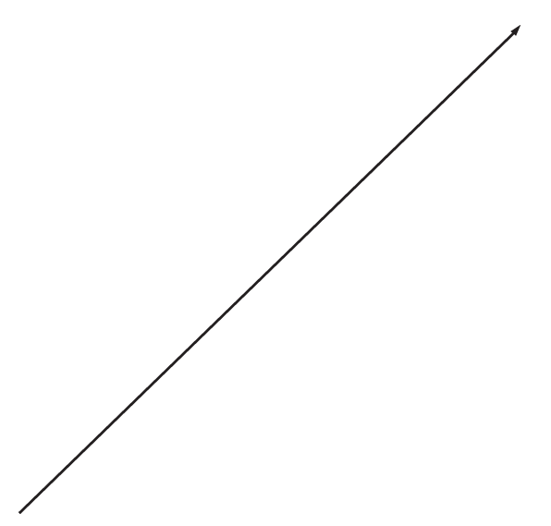

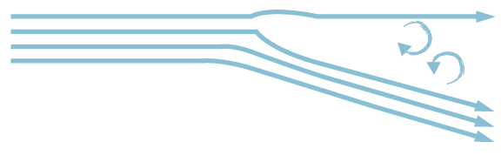

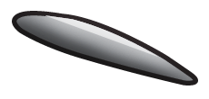
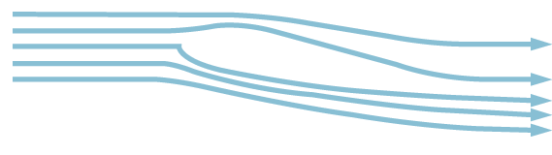
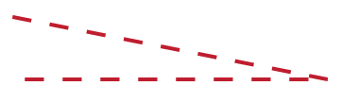

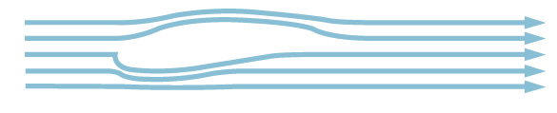


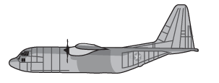


Aircraft Flight Dynamics (cont.)
Stall of a Wing
Resultant Lift Direction
Angle of Attack
Notes:
This slide explains what happens when a wing stalls in flight.
1st click- Lift is also being created by the aircraft. The lift must overcome the weight (gravity) of the aircraft for the aircraft to lift into the air. Explain that you will now go over how air flows over the wing in different angles of attack.
2nd click- Here is the wing in a low angle of attack (nose down attitude) and the equivalent air flow over and under the wing is shown. The red line emphasizes the wing’s angle of attack.
3rd click- Now the wing is in a slightly higher angle of attack (level flight to nose up attitude) and the equivalent air flow over and under the wing is shown. Notice how in this example the air begins to break away slightly from the wing trailing edge. The angle of attack emphasized for this wing shows a straight line on bottom to help show that the wing’s angle of attack is measured from 0 degrees (straight and level flight).
4th click- Here is the wing at an even steeper angle. In this example, we show how, as it runs out of energy, the air flow breaks away from the trailing edge of the aircraft and causes turbulence. As the air becomes turbulent, the smooth, fast airflow over the top of the wing stops, along with the low pressure that this airflow created, causing the wing to stop generating lift or to stall out in other words. Again, the angle of attack is emphasized. As the angle of attack increases, the wing becomes more prone to stalling. Wide wings will stall before thin wings do.

Slide 7
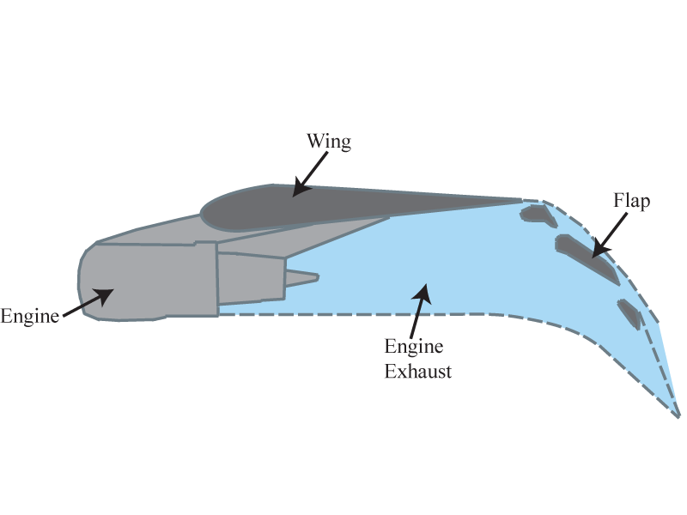
Aircraft Flight Dynamics (cont.)
Stall of a Wing (cont.)
  Externally blown flap:
  Engine thrust blows through gaps and over the back side of the flap to create lift.
  Where is induced drag being created on this wing?
  Where is parasite drag being created on this wing?
Notes:
Explain to students that there are ways that aircraft are designed to try and overcome wing stall. Sometimes, engine exhaust is used to continue to force air over the top of the wing to reduce an aircraft’s tendency to stall.
The C-17 blows exhaust over the top of the flap through a gap between the trailing edge of the wing and the top of the flap. This creates more lift and allows it to take off in a much shorter distance. Also, as the flaps extend, the center of lift moves backward, and as angle of attack increases the center of lift moves forward.
(side note: For an airplane to fly sideways like the Thunderbirds do, the nose of the fuselage is pointed up away from the ground. This makes the side of the fuselage act as a wing, with a positive angle of attack.)
Click #1- Question slide- Answer is: Behind the flap you are getting tremendous amounts of induced drag because the lift being created on the flap pulls out on them at 90 degrees from the flap surface. This is the very reason why the flaps are at 15 degrees on takeoff, which increases lift significantly without excessive induced drag. For landing, we are trying to increase lift and drag to slow the gliding aircraft down, so we extend the flaps to 40 degrees.. Induced drag is created by the lift pulling at 90 degrees to the wing surface. Parasite drag is produced from laminar friction (air friction on aircraft surfaces, such as wing skin) and any bumps or outcroppings.

Slide 8
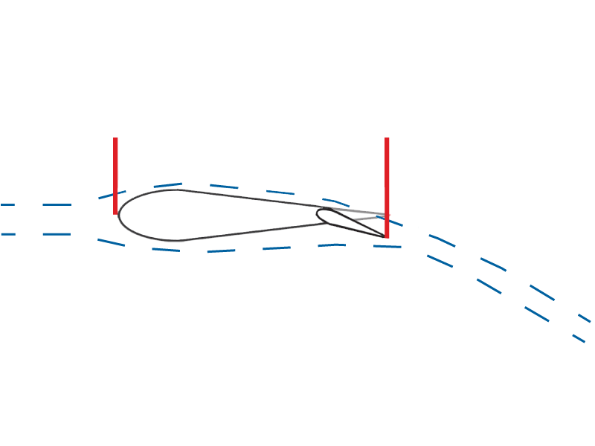
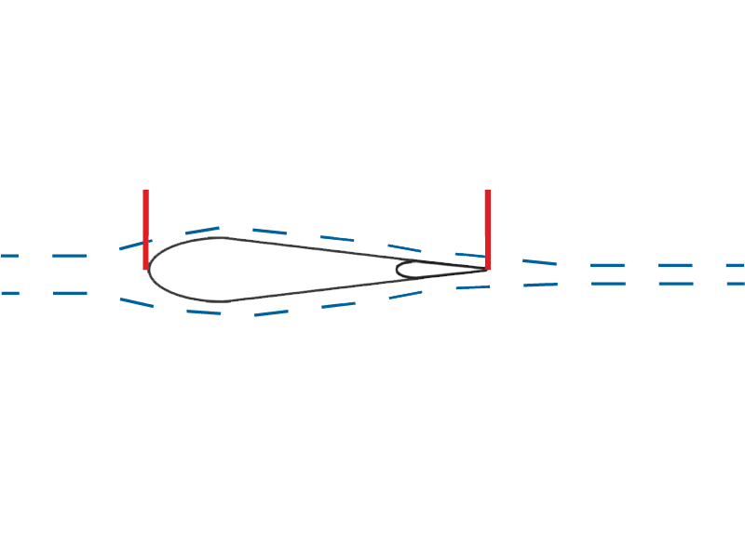
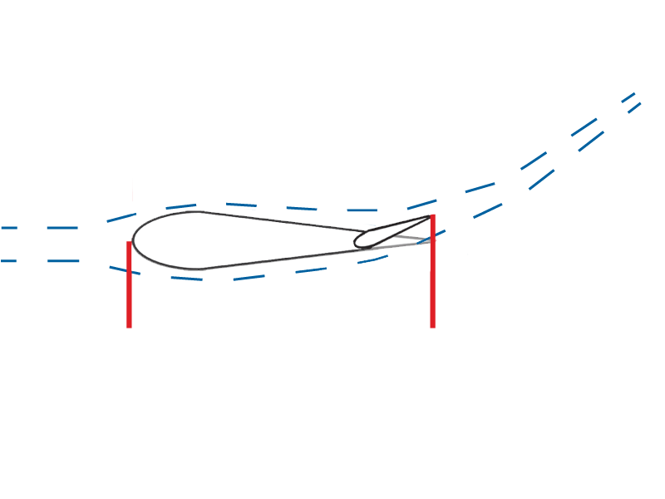
Aircraft Flight Dynamics (cont.)
Symmetrical Wing
  - Angle of attack
  - Trailing edge movement- reshapes entire wing
  - Aerobatics
Notes:
Talk about what happens to a symmetrical wing when it changes angle of attack. Talk about where these type of wings may be found on an aircraft (i.e. rudders are shaped this way.) The movement of the trailing edge reshapes the entire wing.
Click #1- Talk about what happens when trailing edge moves down- that this in essence increases the velocity of the air over the top of the wing, resulting in more lift on the top side of the wing.
Click #2- Talk about what happens when the trailing edge moves up- that this in essence spoils the lift being created on the top side of that wing and increases the lift on the bottom side.

Slide 9

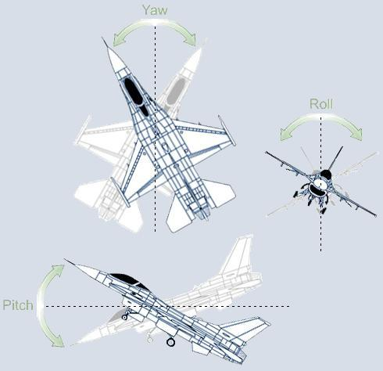
Aircraft Flight Dynamics (cont.)
Flight Control
- Yaw
- Pitch
- Roll
Notes:
As the plane moves through the air, there is always drag acting in opposition to the thrust being produced by the aircraft engine. The thrust of the engine must constantly overcome this drag.
Explain the different flight controls that an aircraft has and how they are used to maneuver the airplane in flight. To illustrate this point further, it may be necessary to use a foam airplane model that you can tilt to show the different attitudes involved in flight.
This slide will help the students see where the control surfaces are located and what movements they control, and how they move. As you click this slide, control movements will be demonstrated by red fins that move in the same way the control movements would move.
1st click- Yaw is the rotation along the vertical axis (controlled by the rudder, located on the trailing edge of the aircraft’s vertical stabilizer). The larger the engine on the plane, the larger the rudder needs to be to have any control over the plane.
2nd click- Pitch is the rotation around the lateral axis, or nose up/nose down attitude of the aircraft (controlled by the elevators which are normally located on the trailing edge of the aircraft horizontal stabilizer).
3rd click- Roll is the rotation along the longitudinal axis of the plane (controlled by the ailerons, located on the trailing edge of the aircraft wings).

Slide 10
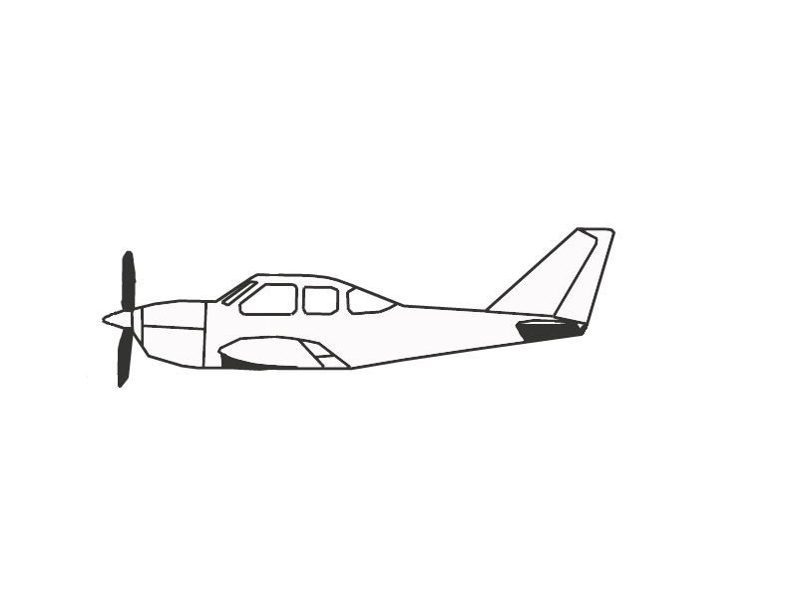
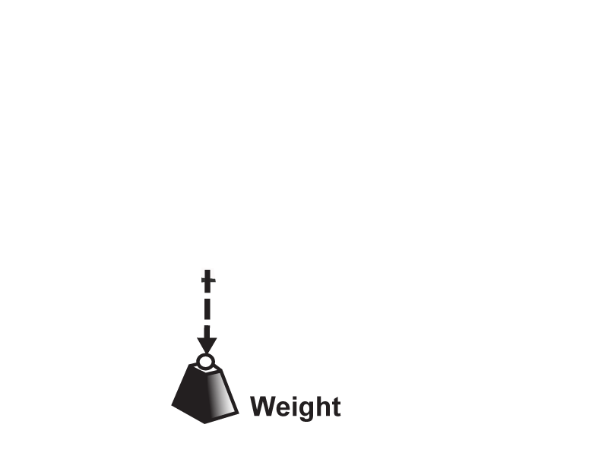
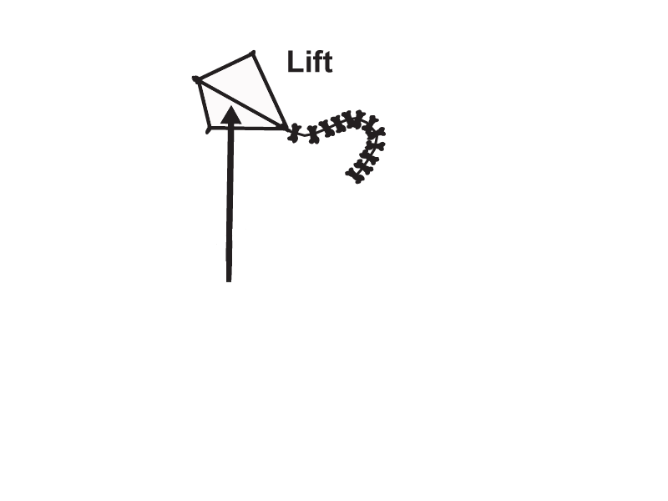
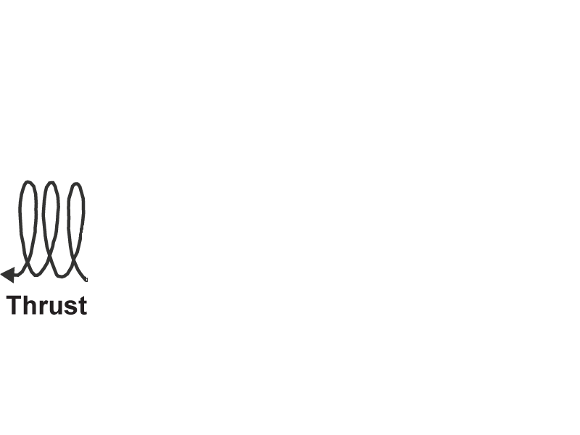
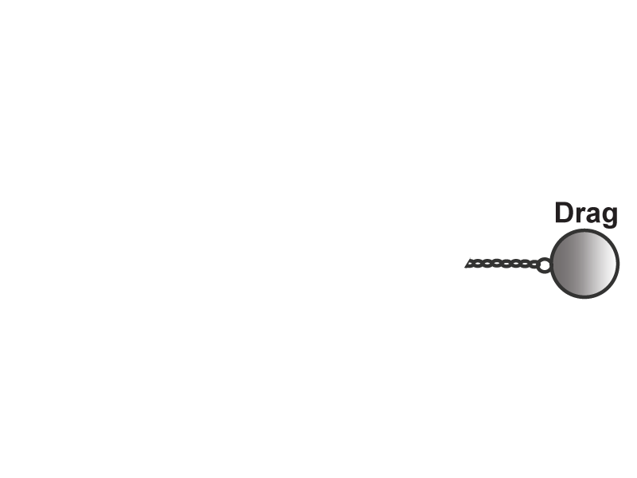
Aircraft Flight Dynamics (cont.)
Flight Loads
- Lift = Weight
- Thrust = Drag
- Mixing of the above
- Induced drag
- Parasite drag
- Tip vortices
Notes:
We have already introduced these concepts, now you will explain the relationships between these loads.
Click #1- Forward, level flight occurs when the lifting force is equal to the aircraft weight,
Click #2- and thrust overcomes the drag force on the aircraft.
Click #3- Explain what happens when the loads are mixed. Talk about the thrust to weight ratio of the F-16 (generates about 30,000 pounds of thrust).
If thrust exceeds drag, then the plane is accelerating. If lift exceeds weight, then the plane is climbing. Parasite drag is the drag that is caused by the air dragging over the surfaces of the plane. Tip vortices are created off the tips of the wings. Many times longer wings or vertical wing tips are used to try and slow these vortices down .

Slide 11
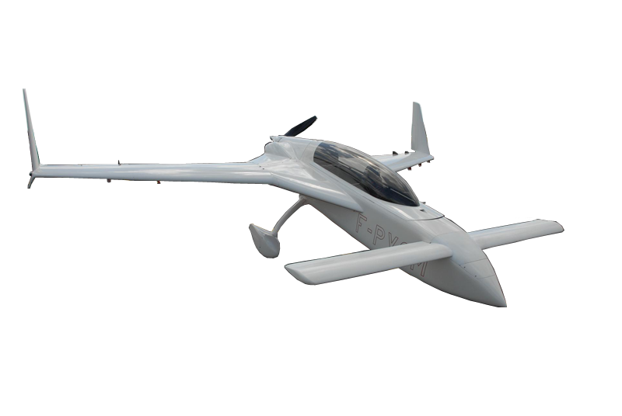
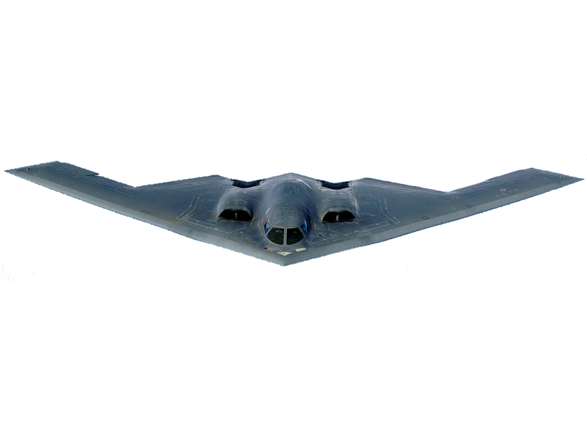
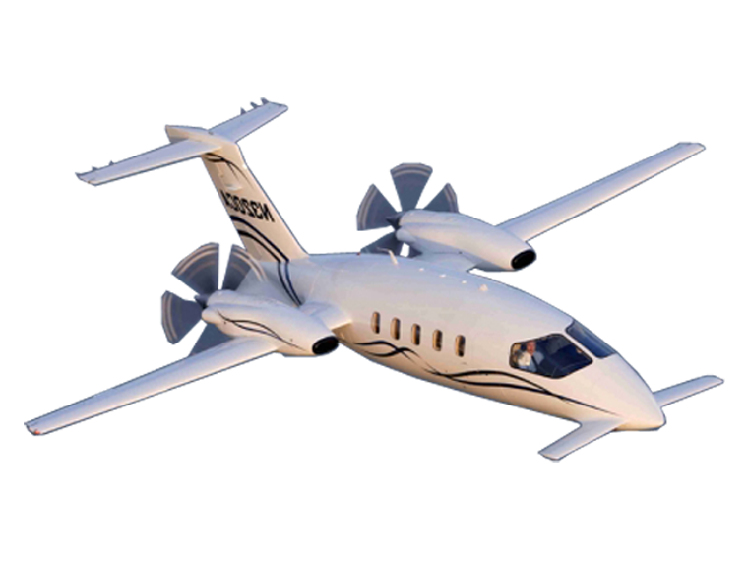
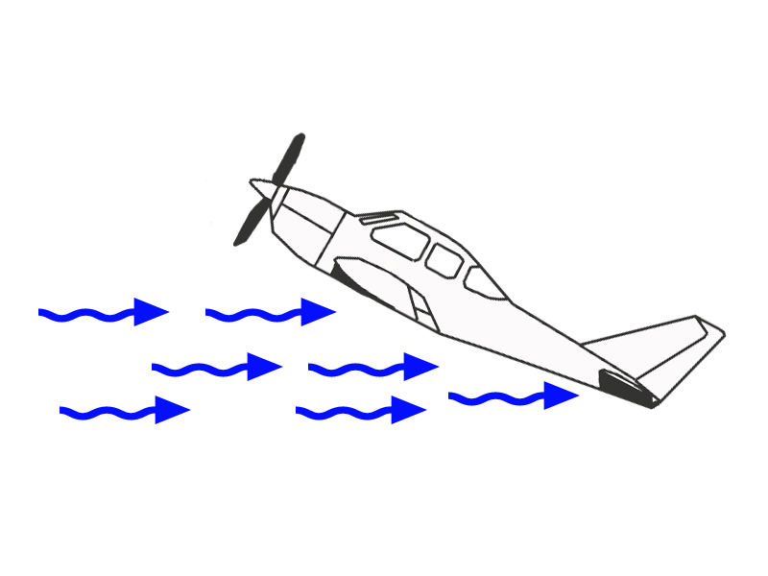
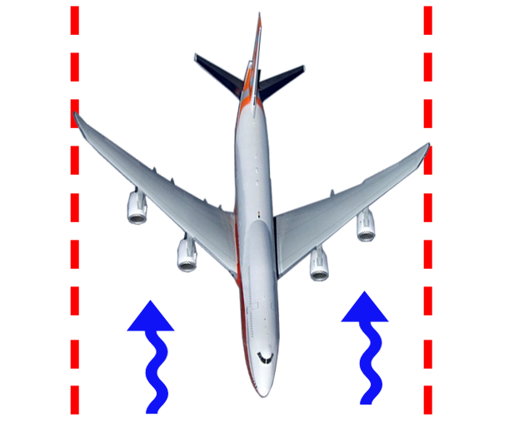
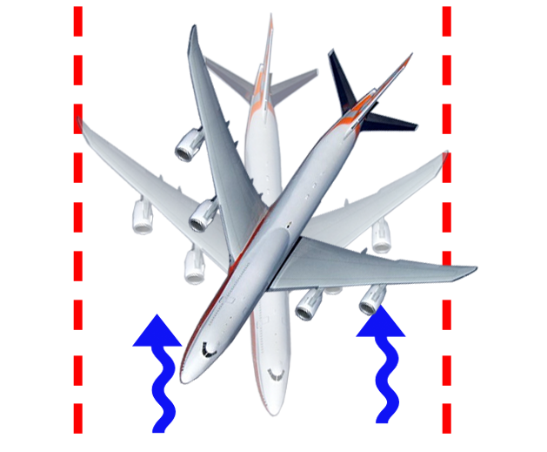
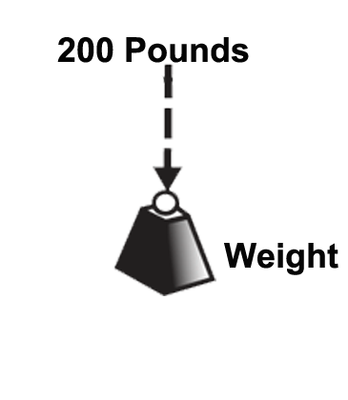
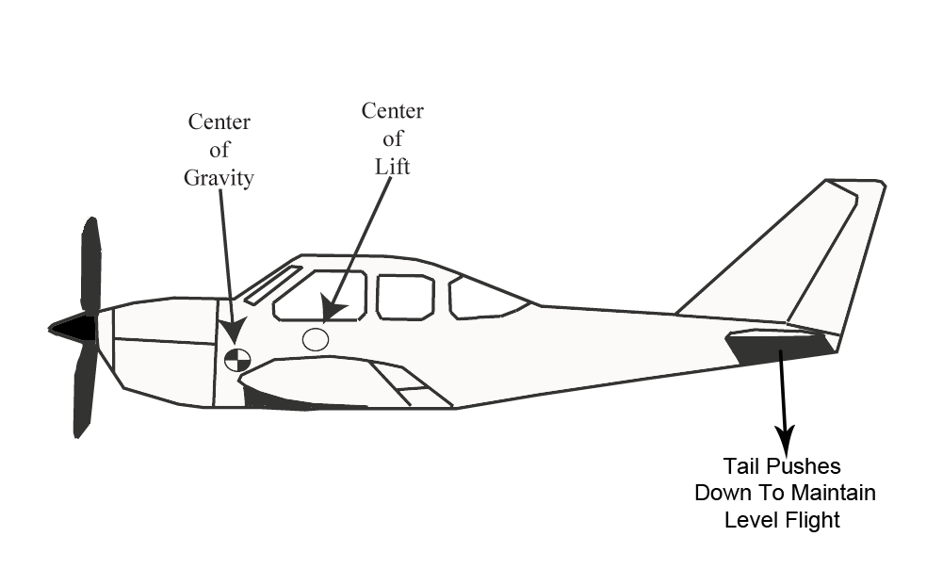
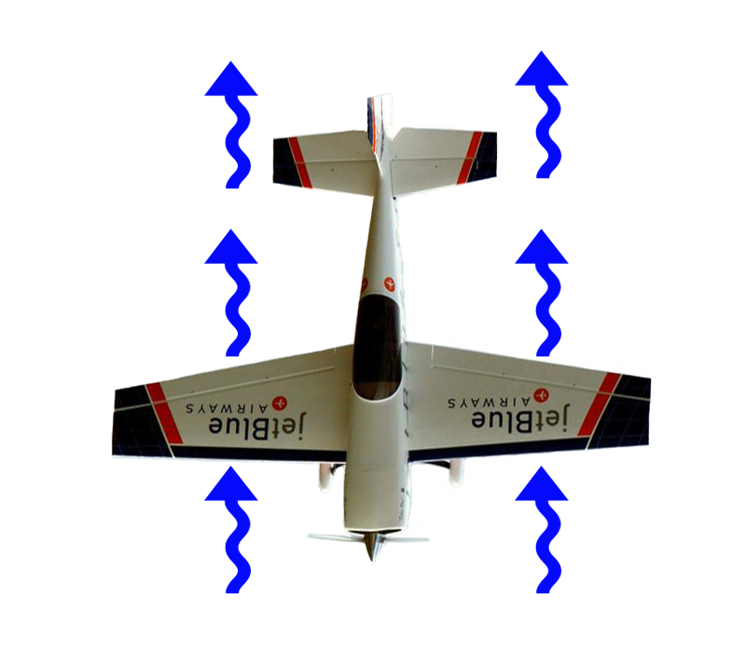
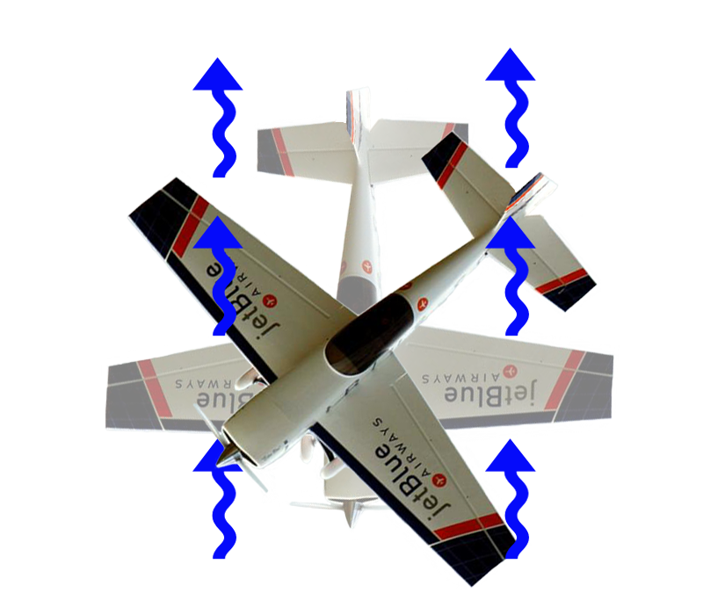
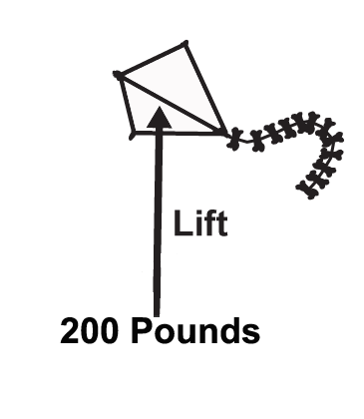
Aircraft Flight Dynamics (cont.)
Why does this plane have a canard?
Why does it have a horizontal tail also?
Why does it have pusher props?
Why is the fuselage shaped the way it is?
How does a swept wing affect aircraft stability?
Stability
- Center of gravity vs. center of lift
- Deep stall (wing washout)
- Flat Spin
Where is lift being created on this aircraft?
Notes:
Explain the characteristics of stability and how airplane design effects stability. To illustrate this point further, it may be necessary to use a foam airplane model so you can show how stability is designed into an aircraft. Wing washout is avoided by twisting the wingtips down into the oncoming air so that they are at a lower angle of attack and so remain flying in a deep stall. If you push down on the tail with 200 lbs of force, your wings must lift that extra 200 lbs, which makes for a very inefficient aircraft.
Talk about positive and negative Center of Gravity. Explain to students that if the center of gravity is too far aft, when the plane stalls, it will fall tail first to the ground, never being able to resume flight since the air is travelling the wrong direction over the wing.
This is why the center of gravity needs to always be located in front of the center of lift, which is normally located towards the leading edge of the wing. For high performance aircraft, the center of gravity will be placed closer to the center of lift. This is dangerous, but more efficient. A flat spin results when the center of lift is equal to the center of gravity.
Clicks #1 and 2- Talk about how a conventional tail adds stability to an aircraft because the oncoming air wants to push the vertical tail back to a straight position.
Click #3- Talk about the difference in planes that use a conventional tail versus using a canard. This plane lifts on the nose instead of pushing down on the tail.
Click #4- This is a Piaggio Avanti aircraft. It uses both a canard and a T-tail for stability. Using both of these methods allows you to lift more on the nose of the aircraft, and push down less on the tail.
Question answers from top to bottom: 1- The canard lifts on the nose to improve the efficiency of the aircraft by reducing the amount that the tail has to push down to keep the nose up.
2-It controls the pitch and shares the load with the canard.
3-This allows the props access to clean air that doesn’t have turbulence.
4-If you look closely at the fuselage, it has a wing-shaped fuselage so the entire fuselage generates lift.
Click #5- Talk about how a flying wing flies. Flat spins happen more in fighter aircraft because the center of gravity and the center of lift are in the same place to make them inherently unstable. When a flying wing stalls, the center will stall first while the wing tips are still flying, which allows you to maintain control while in a stall.
Explain that the wing cross section is fatter and longer near the fuselage than at the wing tips. This causes the wing to stall inboard first. The tip of the wing is also twisted downward on most planes so that it is the last part of the wing to stall. The wing right next to the fuselage will stall before the wingtip does. This is why the ailerons are located on the tips of the wings, so that lateral control of the airplane is always maintained.
Answer to question- lift is actually created off of the canopy area as well as the engine nacelles.
Part of the FAA certification (type certificate) of an airplane is to take the plane into a deep stall (wings no longer generating enough lift to keep the plane in the air (wing washout)) and show that it still maintains lateral control, which shows that the wing tips are still flying.
Clicks #6 and 7- Discuss how a swept wing adds to aircraft stability.

Slide 12
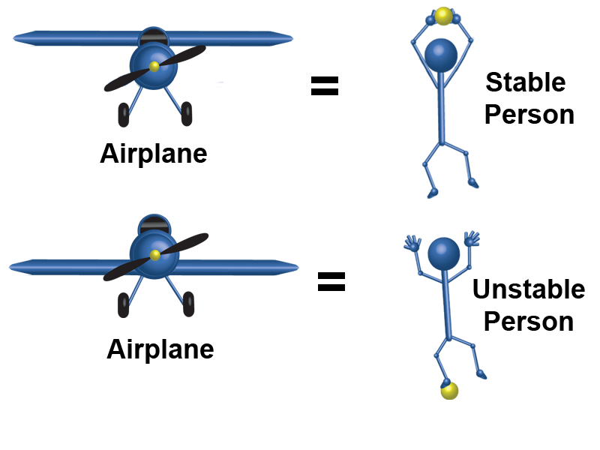
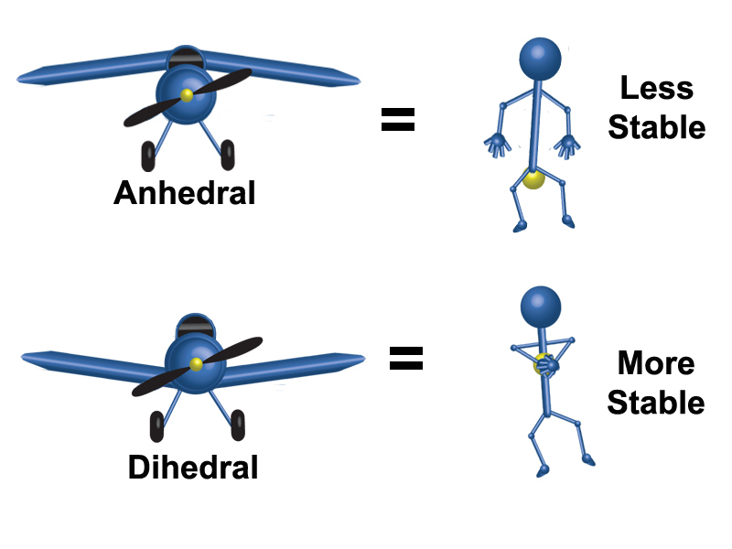

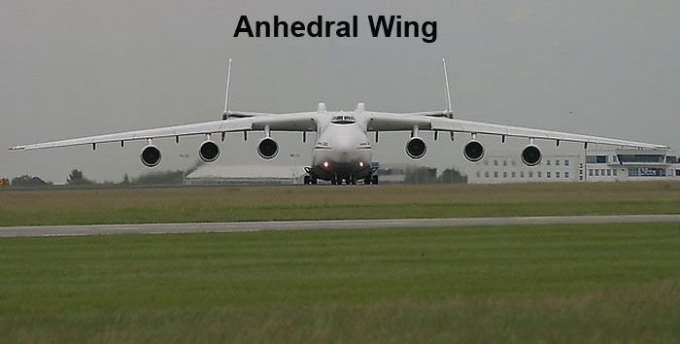
Aircraft Flight Dynamics (cont.)
Do engines shown add to or decrease from the stability of the aircraft?
Why have dihedral on the tail?
-Why have anhedral?
-Why have twin tails?
Stability (cont.)
- Center of gravity vs. center of lift
- Airplane design affects stability
Notes:
Explain the characteristics of stability and how airplane design effects stability. To illustrate this point further, it may be necessary to use a foam airplane model so you can show how stability is designed into an aircraft.
Talk about the difference between using a high wing and a low wing. Analogy of a person dangling under a rope for a high wing, and standing on top of a rope for a low wing. High wings are more stable than low wings.
Click #1- Explain the difference in stability between a dihedral and anhedral wing. A dihedral wing is stabilizing while an anhedral wing has a destabilizing effect on the aircraft.
Answers to Questions- Engines add stability because they are located under the wing.
- The dihedral on the tail increases the plane’s stability and also reduces tip vortices off the tail.
- This plane has anhedral wings because it is such a big plane that without that inherent stability built into it, it would be uncontrollable any other way.
- This plane carried the Soviet space shuttle. With the shuttle installed in the mounts on top of the plane, a single tail would have been masked by it and you wouldn’t have any yaw control. The twin tail solves that problem.

Slide 13
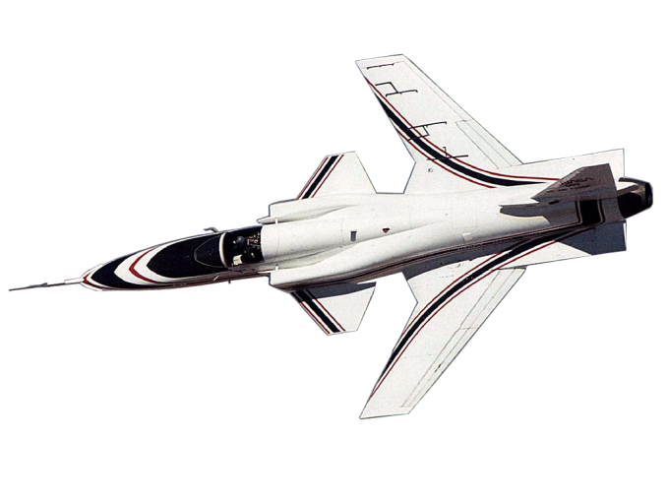
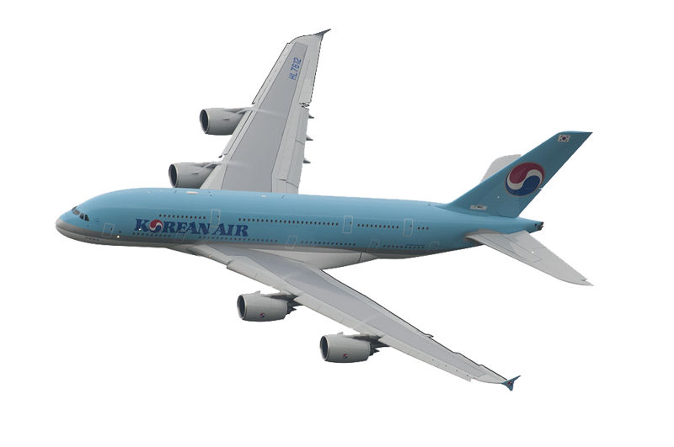
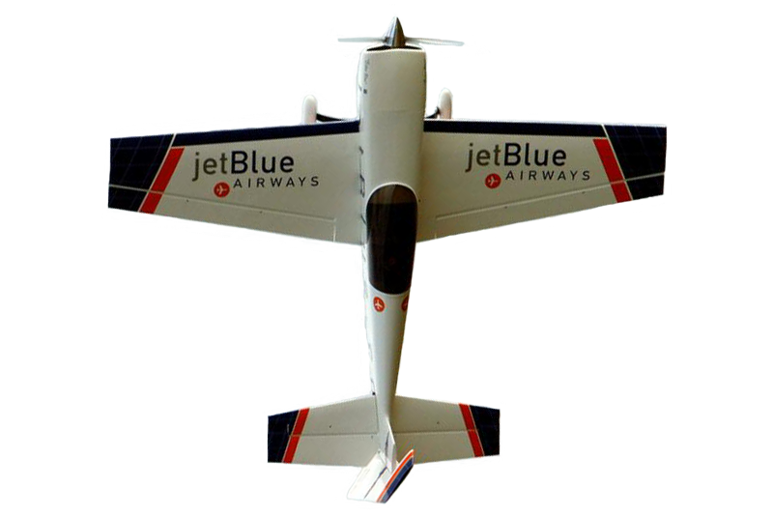
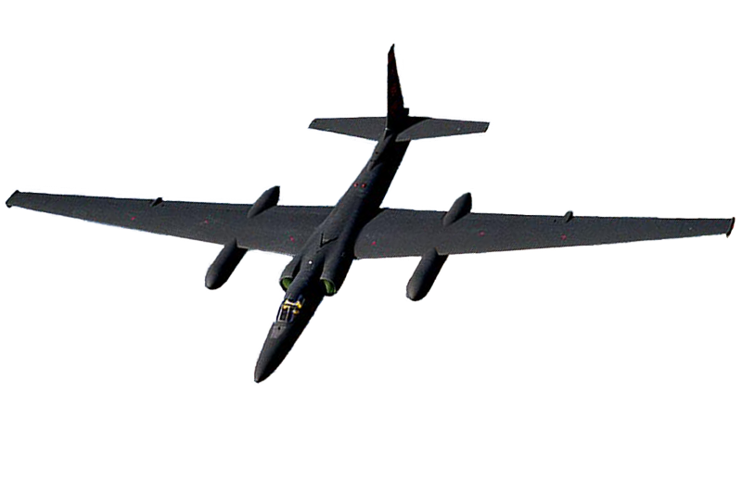
Aircraft Flight Dynamics (cont.)
Stability (cont.)
Why is this wing swept forward?
X-29
Why is this wing swept back?
Why is this wing shaped this way?
Why is this wing so long?
Air Show
Flyer
Commercial
Airliner
U2
Notes:
Talk about why different planes have different shapes of wings depending upon what the plane is designed to do.
The U2 was designed to perform at high altitudes, and thus has a very long and thin wing to be able to make use of the thin air found at high altitudes.
Commercial aircraft are designed to be very stable and safe. The swept back wing of an airliner contributes to its stability.
Air show planes are built to be unstable enough to allow them to perform lots of aerobatics, stall at the largest part of the wing, but allow the pilots to have control so that he can still recover.
X-29 was one of the most unstable aircraft ever built. Was designed to perform high angle of attack flights and gather research on airplane stability in high angles of attack. The wing was swept forward because it added to the inherent instability that this plane needed to have. The research gathered by these planes can be found in a lot of the computer models that engineers use to design planes. It was flown primarily by 3 computers because the human pilot could not respond fast enough to fly it safely. If any of the computers encountered any problems, the pilot was automatically ejected because the plane would self destruct in about 3 tenths of a second.

Slide 14
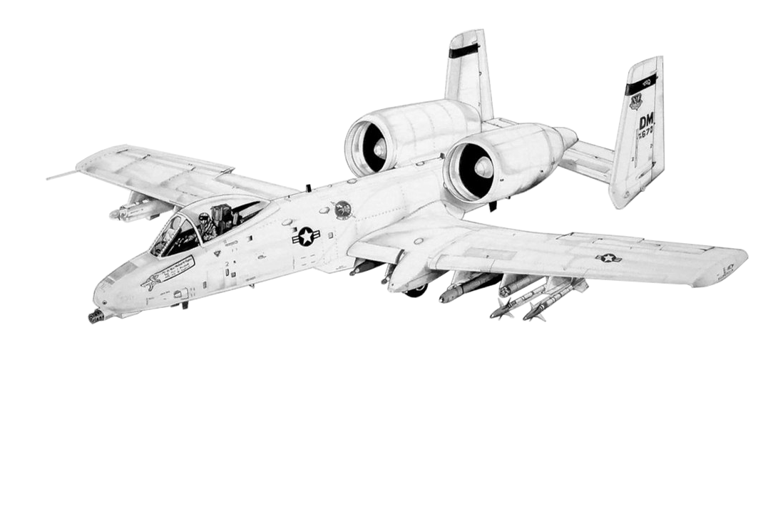
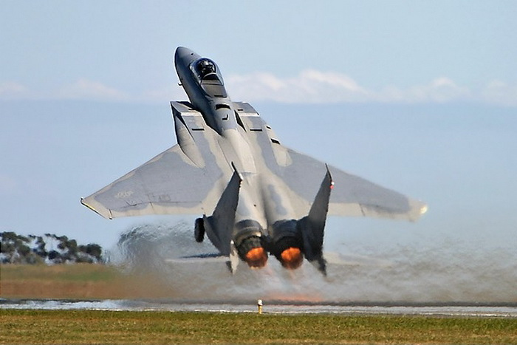
Aircraft Flight Dynamics (cont.)
Stability (cont.)
Why are the engines mounted so high?
Why does this aircraft have twin tails?
What does the down-canted engine exhaust do for stability?
Fighter aircraft are generally unstable
Notes:
Explain the characteristics of stability and how airplane design effects stability. To illustrate this point further, it may be necessary to use a foam airplane model so you can show how stability is designed into an aircraft.
Answers- The engines are mounted high off the ground because they are less prone to picking up FOD on dirt or gravel runways and it also makes them harder to hit in combat.
Twin tails give more yaw authority for targeting purposes.
The down-canted exhaust improves stability by helping the tail to support the weight of the nose without having to use elevator to push the tail down.
Click #1-Talk about different wing sweeps (straight wing and forward swept wing) and how they affect stability. Talk about the effect that stability has on the aircraft fuselage.

Slide 15
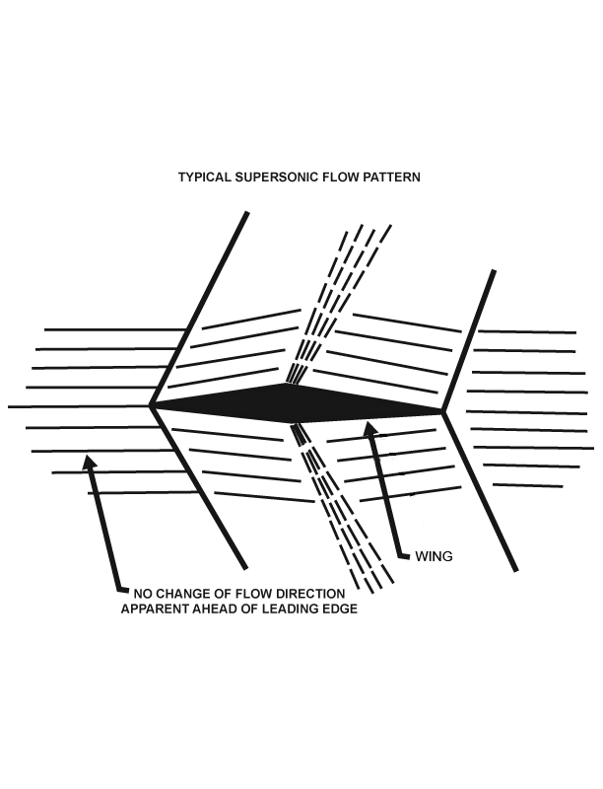
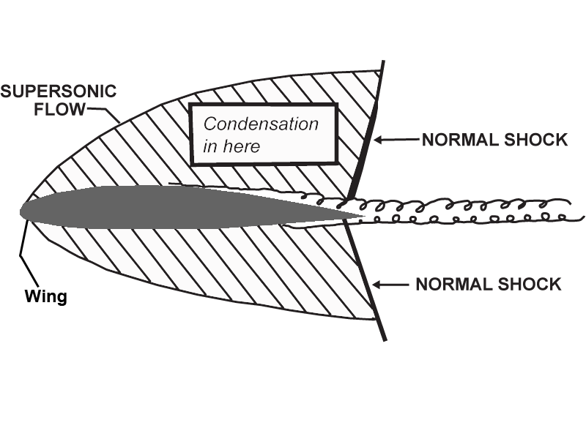
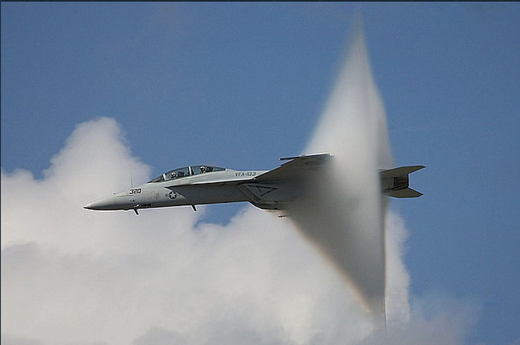

Aircraft Flight Dynamics (cont.)
Supersonic and Subsonic Differences
- Round airfoils vs. Diamond airfoils
- Elevators vs. tail planes
- Low speed control and lift
Notes:
Explain differences between supersonic and subsonic airfoils. Again, the whiteboard may come in handy when explaining these differences.
A round airfoil works well for subsonic planes because as the plane flies through the air, a pocket of stagnant air forms in front of the wing. Air slides over air easier than it does a sharp nosed wing. However, there is still more energy loss in this type of wing than in a thinner airfoil. A diamond airfoil is used on supersonic aircraft because in supersonic flight the air is compressed. You will also notice that the wings are very thin with very little airfoil. That’s why some of these planes have leading edge slats that lower on the front of the wing that give it the airfoil for the lower speeds required on takeoff and landing.
Biggest difference is the location of the center of lift, or aerodynamic center, in supersonic versus subsonic airplanes. This point is farther aft on the wings of supersonic planes than on subsonic aircraft.
1st Click- Picture of actual aircraft with air condensation so that you can see how the air flows over the wing.

Slide 16
Basic Aircraft Structures
Basic Aircraft Structures Overview
G Loads
Structure Flex
Structure Primer Wing
Structure Primer Fuselage
Notes:
Explain that these are the sections to be discussed in Unit 2.

Slide 17





Basic Aircraft Structures (cont.)
G Loads
- Positive and negative G loads
- Maneuvering loads
- Gust loads
- Landing and ground operations
- Airplane obesity
Notes:
Every plane has a positive and negative G load limit. Pulling more G’s than a plane is designed for overstresses the components. Use the A-10 as an example, it has a positive 7.8 G and a negative 2.8 G limit.
Click #1- Use the example of sitting in the seat of a passenger airliner, and how it feels when the plane rises, and falls, and turns to illustrate the different loads experienced as the plane maneuvers. A person sitting in a seat by themselves is representative of 1 G,
Click#2- while six people sitting upon that person is what 7 Gs feels like.
Click #3- The example is used of a farmer’s field with a pond nearby, where the air is heated over the newly plowed field, and is cooled over the pond. The air rises over the field, and drops over the pond. This creates different gusts of air. Usually this is not a problem because the aircraft is moving at such a rate that it covers the distance in a matter of seconds. The air is very gentle and is moving slowly, but because the airplane passes through this transition quickly, it feels rough. It is felt as turbulence (bumpiness) as the aircraft moves though the air. When wind shear is created, as in a thunderstorm, a drastic slamming of air occurs that is seen as an instantaneous change in direction by the aircraft wing and can cause erratic flying in severe conditions.
Click #4- Discuss landing and ground operations.
Click #5- After an aircraft is first manufactured, it is normally the “stripped-down model”. Over its lifespan, items are added to the plane that increases its weight. For instance, if there is a new navigation pod we want to add to our airplane, but it will add a bit more weight to our aircraft, it may be necessary to add more structure in the wing to carry the added load, which adds weight in and of itself. So it is easy to see how an aircraft can grow in weight over its lifespan. (thin skin F-16 wing weighs over 1000 pounds less than the thick skinned wing)

Slide 18


Basic Aircraft Structures (cont.)
Structure Flex
- Effects on angle of attack
- Center of lift location
- Ground loads (Board Discussion)
Weight of fuel and cargo
Touch down impact
Braking turn
As center of lift changes, it twists the wing.
Gusts coming at the wing change the angle of attack.
Notes:
Discuss structure flex and how angle of attack effects the flexing of the wing. The top of the fuselage is in tension, while the bottom of the aircraft is in compression. Use the white board to illustrate this concept. Suggested drawing and discussion are located on the next page in the guide.
Click #1- When the wing is in a pitch up attitude, the lift created on the wing moves from the aft part of the wing to the forward part of the wing. The center of lift on the wing changes and ends up closer to the leading edge of the aircraft in a pitch up attitude than when it is flying flat and level. As the wing flies, it is constantly being subjected to torsion stresses as the wing tries to change shape. So, it is not exactly true to say that the bottom of the aircraft is always in compression, while the top is always in tension, because torsion stresses are being introduced constantly as the control surfaces are used to maintain correct attitude. We generally do have more repairs to make on the top of the wing than on the bottom of the wing because of the stresses they are subjected to.
Click #2- When an aircraft is on the ground, most of the loads on the components are reversed. For example, the wings are being pulled downwards by gravity, especially if there are engines mounted on the wings. Turning stresses are being transferred into the fuselage by the landing gear, and especially the nose landing gear during taxiing, instead of through the rudder. When taxiing, the tires are pushing out on the sides of the wheels with tremendous force. Over time this fatigues the corners of the wheels and causes them to crack and can cause failure if not detected early enough.
This is the illustration you must duplicate on the whiteboard. This shows how the wing flexes.
The flex of the wing acts as the suspension for the aircraft. As the wing flexes, the upper skin of the wing will go into compression, while the lower skin goes into tension. This is why different types of material are used on the top and bottom of the wing, because they are under different loads. When the plane is in a negative G maneuver, the roles are reversed and the top of the wing is in tension, while the bottom is in compression. So, in very maneuverable planes, equal strengths of material must be used on the top and bottom of the wing to compensate for the different airplane attitudes.
Something to think about: The wing of the C-17 flexes 17 feet at full positive G to negative G limits. This stretches the aluminum .0006 per inch in the top and compresses it similarly on the bottom-most areas of the wing. This may not seem like much, but you have to think of how much stress the aluminum is under for it to do that kind of stretching and compressing.

Slide 19



Basic Aircraft Structures (cont.)
Structure Primer Wing
- Spars
- Ribs
- Stringers
- Skins
- Wing box
Notes:
When we look at the cross section of the wing, there are upper and lower spar caps that look like two T’s. One located on the upper side of the inside of the wing, and the other installed on the lower side. These carry the primary loads from the wing into the fuselage. A thin sheet metal web is attached to the front side of these spar caps. Metal stiffeners are then also riveted to the front of the spar cap to add rigidity to the whole spar structure. Toward the aft end of the wing, there is another spar built the same way as the forward spar, with spar caps on top and bottom and a metal web and stiffeners attached to those caps.
Click #1- Bulkheads are riveted to these spars as well to add interior strength. These form the ribs of the wing. These bulkheads have holes in them to allow fuel to flow through them and to lighten the structure as well. These holes would also weaken the bulkhead if we did not put lightening beads on them to stiffen the structure around those holes. You need to be careful not to ding any of these lightening flanges when working anywhere around bulkheads. They are not neat decorative flares, they have structural significance in adding stiffness to the bulkhead, which may fail if those flanges are damaged.
Click #2- If this was all there was to the wing structure, we’d still get a lot of twisting up and down as the wing flexes, but there are components installed to prevent this. Stringers are riveted to the ribs (little Z or J structures between the skin and bulkhead) to add strength to the skin that helps it hold it’s shape under loads.
Click #3- The wing skin is riveted right to the stringers.
Click #4- This is how we create the wing box. It is important to help the students understand that we do not carry extra metal around on an aircraft. If a part didn’t have to be 30 thousandths of an inch thick, it would have been manufactured at 20 thousandths instead to save weight and materials.

Slide 20




Basic Aircraft Structures (cont.)
Structure Primer Wing (cont.)
- Leading edge slats
- Trailing edge components
- Shear clips
Notes:
Shear clips are employed to attach the bulkhead to the stringers, depending on aircraft design.
Click #1- The leading edge and other control surfaces of the wing are attached to the front of this wing box structure we just described. On some aircraft, leading edge slats are employed to increase lift during takeoff and landing.
Click #2- The ailerons are attached on the aft end of the box structure, or the wing’s trailing edge. The wing may also have flaps and spoilers attached to the trailing edge of the wing.

Slide 21






Basic Aircraft Structures (cont.)
Structure Primer Wing (cont.)
- Tension, compression, torsion
- Center of lift changes
- Big bone parts
Notes:
This picture represents wing flex.
Click #1-4- These clicks show how the wing stresses change when the aileron moves up as opposed to when it is in a neutral position.
You can ask a question here: How far do you think a C-17 wing can flex without breaking? Answer: C-17 wing is designed to flex 17 feet.
Wing generally is in compression (pushing material together) on the upper surface, and tension (pulling material apart) on the lower surface. Torsion occurs when the wing is subjected to a twisting force. As a component is twisted, the distance between a point marked on the forward edge of the part and a point marked on the aft edge of the component becomes shorter. At the same time, other points on the part are becoming farther apart. Torsion stresses combine compression and tension crossed over each other.
Click #5- This is a prominent result when the rudder is used to yaw the aircraft. The fuselage will experience a torsion load.
Question: Will a crack continue to grow when the material is in tension, or is it more likely to get worse in compression? (only gets worse in tension, as the material is being torn apart) You can use the example of a banana peel. If you start a tear in a banana peel, will it continue to tear as you pull it, or as you push it together?
Answer: It will only grow as you pull it (in tension).
As the control surfaces deflect to make the wing move, the shear forces are transferred through the box structure of the wing to resist the wing changing shape, and to resist the force of drag on the wing as it moves through the air. As the wing flexes backwards, you get a diagonal force of compression in one direction with a tensile force across the wing diagonally in the opposite direction. The wing box acts like a barn gate and transfers those loads back to the fuselage. Once again, when working on an aircraft and we ding the skin, we need to understand that the skin is carrying loads as well and thus is subject to failure like any other aircraft component.
Click #6- Big bone parts are those parts that transfer primary loads, such as wing spars, landing gear attachments, door frames, floor beams, etc.

Slide 22





Basic Aircraft Structures (cont.)
Structure Primer Fuselage
- Skin
- Frames
- Longerons
- Shear clips
- Intercostals
- Big bone parts
Notes:
This is a piece of skin from the fuselage.
Click #1- This is what a frame looks like. A frame is a primary transverse structure located around the circumference of the fuselage, serving principally to support longitudinal structural members of the fuselage.
Click #2- A longeron is a principal longitudinal member of the framing of an aircraft fuselage and is usually continuous down the length of the fuselage.
Click #3- Shear clips are also employed to help carry the load, transferring from frames to skin.
Click #4- Intercostals are primary members that connect ribs, frames, or two or more parts. It is used to support fixtures and equipment (luggage racks, electrical panels, etc.)
Click #5- Big bone parts on the fuselage are located in a few areas, like where the landing gear attaches to the fuselage.

Slide 23
Aircraft Components Loading
Aircraft Components Loading Overview
Loading of Component
Fracture Critical Components
23
Notes:
Explain that these are the sections to be discussed in Unit 3.

Slide 24








Aircraft Components Loading (cont.)
Loading of Component
- Types of loads
- Fasteners share loads
- Neutral axis
- Dings and other damage
24
Notes:
Suppose we have a strap that has six holes that are supposed to be drilled in it at 0.250 plus 000 minus 0.2. We have a bad day and get a dull drill and drill one of the holes to 0.253. Close enough, we figure, so we ship the part. When the part is being installed on the aircraft, the maintainers don’t notice that the one hole is 0.253, so they put a regular sized fastener into it.
1st Click- When the part is stretched, that one oversized hole becomes oblong because it is not completely filled by the fastener. The fastener also is not carrying all of the load it is supposed to be as a result of it not completely filling the hole in the part. This creates a load peak around that one hole, overloading the part in that area. As the hole compresses down, it can start forming cracks at the four edges of the hole because the stresses are different in those areas.
2nd Click- Now, if you have the same scenario on a part that goes into compression, you get an oblong hole in the other direction, and the same thing happens, the part is overstressed in that area. If the part stays in compression the cracks won’t spread, but once you put the part into tension then those cracks can actually cause that part to fail.
3rd and 4th Click- If any portion of a hole is left unfilled (think of a sloppily drilled hole that has an odd shape), it will be subject to cracking and failing when a load is applied to it. Say you grab an oversized reamer to fix a hole you drilled sloppily the first time and put an oversized fastener in the hole. Each fastener in the series of three fasteners is supposed to carry 500 pounds of the load. The first fastener picks up its 500 pounds of load from the mating component. Then we come to the oversized fastener, and it picks up 1000 pounds of the load. The final fastener may only pick up 100 pounds of the load or so. The metal around the oversized fastener is being overworked and overstressed and is very susceptible to cracking. This is why if you want to use an oversized fastener, you need to contact your engineer so that they can find a fastener for you that, even though it is oversized, will only carry the 500 pounds that it is supposed to carry, maintaining a balanced load between the fasteners.
5th Click- (Let students know that the following numbers are theoretical and this is why the graphic example shown does not reflect the following example) For another example, think of a stepped strap made of 0.050 material in the thinnest area with a series of four fasteners shot down through it that are supposed to carry 100 pounds each. (This is the strap that is being made for the A-10 longeron to repair some cracks.) The reason we do this is to try and bring the 10,000 pounds of load from the longeron into the strap gradually. The fasteners on the first step of material thickness will be expected to carry 300 pounds each. At full thickness, our fasteners will be expected to carry 1000 pounds each. As the strap tapers back down on the other side, we must do the same thing with our fasteners. If you oversize a hole early on in the strap and put an oversized fastener in there, you run the risk of loading the strap too quickly, causing it, or even the longeron under it, to crack and fail. The main point here is to emphasize to students that if they have to oversize a hole for any reason, they must consult the engineer so that they know what kind of fastener can be put in place so that the strap load is evenly distributed the way it was designed to be.
Question: How do we oversize a fastener and maintain the original hole loads?
Answer: Use a fastener made out of a softer material, or use bushings to fill the oversized hole and install the original fastener.
On this stepped strap, it is important to have the steps blended smoothly. If sharp edges are left on the strap, as the part goes into tension, that sharp edge is a natural place for a crack to start. Leaving those sharp edges on the strap is like manufacturing cracks into it before it ever goes on the aircraft. (Rubber Strap Demonstration)
6th Click- If you ever need to take material out of an aircraft component or fastener, it is best to remove material out of the center because that is where it is not under any load. This is known as the neutral axis of the fastener or component. This is why wing spars are thin in the middle and thick at the ends. This is also why we employ hollow bolts in aircraft applications.
7th Click- Explain what happens, with the graphic, when the skin or a part is dinged.

Slide 25












Aircraft Components Loading (cont.)
Loading of Component (cont.)
- Offset loading and pin bending
- Fastener patterns
- Cutouts (Board discussion)
- Preloading a part
- Bushing
- Doubler
Aloha and Southwest Airlines
25
Notes:
Shims are used to correct a gap difference between two surfaces that need to be joined. Anywhere you put a shim will fatigue faster than a place where you don’t have to put one because of how it changes the load path. When using a shim, it is best to attach it in such a way that the load is transferred as smoothly as possible by attaching a portion of the shim to the aircraft structure. If you choose to not use a shim, however, and just force the two pieces together, then you have most likely bent the material out of normal alignment. If you haven’t bent the material, then you have at the very least preloaded the parts which reduces the amount of load they can carry and will cause premature failure. This can occur even with light clamping of material to bring them together. If you can’t push material together with finger pressure, then you will have to use a shim. Talk about problems with liquid shim, how it turns into powder over time and so you have a joint with no shim that is allowed to move and crack.
1st – 5th Clicks- Fuselage skin splices are used to join the top skin to the bottom skin. The splice will have a row of soft rivets around the outside with a main working fastener with at least two other fasteners in a staggered pattern to gently transfer the load from one skin to the other. You can’t use huge bolts in a skin splice because the skin itself will just start cracking all around the bolts if they are too strong and don’t allow any flex. On a 737, they used three rows of fasteners with glue in between the skins to bond them together. Because the joint is where an offset of loads occurs, it will constantly be trying to move. If the glue is prepped wrong, it may cease to adhere and the material will stretch and begin to crack around the fasteners. This is what caused Aloha and Southwest Airlines to blow the top off of their airplanes. The glue failed and they didn’t detect the cracks in time, and the cracks ran from rivet hole to rivet hole to rivet hole and the pressure broke the skin splice. To make it worse, the place where it failed was close to a door, which is a big place where fatigue occurs and this can be seen in the picture on the slide as well.
6th Click- Talk about how bushings are used. They allow you to use the same fastener to carry and transfer the load the same way it would without the bushing.
7th Click- Talk about how doublers are used. They build the structure to allow it to carry more load and also to help contain cracks.
As the plane flies along and the wing is pushing up while the horizontal stabilizer pushes down, the top of the fuselage is in tension while the bottom is in compression. The neutral axis of the fuselage is the longitudinal center of it. When you have a pressurized fuselage, however, then all of your fuselage skins are in tension and there really isn’t a neutral axis. The floor will also begin to be stretched as the pressure pushes outward on the sides of the fuselage, and it will normally stretch about 2 inches in circumference under 8 psi (C-17 does because the fuselage is 22 feet in diameter). Sometimes the floor resists this stretching force and you get an odd-shaped fuselage when it is pressurized.
8th Click- Fastener patterns- Longitudinal/Butt Splice- This splice is no longer used because it is expensive and hard to build- it lasts a long time, but nobody wants to pay to put splices like this on their airplanes, airliners would rather build the plane cheaper and scrap it sooner rather than have one that lasts for a long time.
9th click- Cutouts- (the picture above will be drawn on the whiteboard) such as access panels on wings, doors and windows in the fuselage. The big access panels are more often located on the top of the wing, since it is in compression most of the time. Around these panels, we build extra structure for stiffness, fasteners all the way around the circumference of the access. You would probably want at least two rows of fasteners around the access panel in order to transfer the loads effectively into the structure surrounding that hole. Similar things are done to stiffen the structure around doors and window belts (this is a large skin panel that encompasses all of the aircraft windows).The larger the cutout is, the more loads have to be diverted around it. This requires more structure. For example, If each inch of structure carries 100 pounds of load, a one inch hole only has to divert 100 pounds around it. A 60 inch door has to divert 6000 pounds around it.

Slide 26







Aircraft Components Loading (cont.)
Fracture Critical Components
- Redundant load path
- Sensitive materials
- Structure designs
- Shot peening
- Cold Working
- Roll Burnishing
Tear Strip is the redundant load path
26
Notes:
A fracture critical component is a component that will cause loss of the aircraft if it were to fail and/or it doesn’t have a redundant load path (another component to pick up the load once that component fails). Fracture critical components cannot be readily inspected because of where they are located in the aircraft. You want your primary structures designed in such a way that a crack in any one component will not cause total structural failure, and will allow the crack to be discovered and fixed on the airplane’s next major or minor inspection.
1st Click- Many of these components have a critical crack length that will cause loss of the airplane. How do you design a part so that its failure doesn’t cause loss of an aircraft? In the example of a spar cap, place a strap on the underside where that spar cap attaches to the skin or stringers of the wing. This way, if that spar cap cracks, it is very likely that the strap will pick up the load, and contain the crack, until the next inspection. Angle doublers can be employed on the sides of the cap to contain any cracks that may occur in those areas. Why not mill complete aircraft parts? Because if a crack starts in one place, it can spread throughout the whole aircraft if it was made as one large single piece of material. By using smaller, layered components riveted together, we contain cracks that occur in various places on the aircraft.
Parts have margin of safety calculations that engineers figure out to determine how safe the airplane is. This has to do with the specific properties of the metal that the part is made out of. A zero or positive margin of safety is what we want to maintain. Engineers will sometimes allow certain parts that are not fracture critical to delve into a slight negative margin of safety. We never want major components to be in a negative margin of safety. Landing gear has a very small margin of safety in order to keep weight down.
2nd Click- Many times a strap will start as a thin piece of material, and will slowly step up to be a thicker piece of material. Why not taper the material? If the material were tapered, the fasteners would be sitting on the tapered surface with only a portion of the fastener head in contact with the surface itself. This stresses the fastener heads unevenly and with a steep enough taper, the fastener heads are prone to being popped off. A stepped surface allows flat spaces for the fastener heads to sit on and properly carry aircraft loads.
3rd and 4th Click- For every pound you add to the fuselage, the stronger your wing components will have to be to carry those loads. For every 12 pounds you save on the middle of the aircraft, you can shave 36 pounds off of the structure. Now, if you find a way to save 12 pounds on the middle of the wing of the aircraft, close to the center of lift of the wing, then you will probably only save 12 pounds because the wing is not transferring that load into the rest of the aircraft structure. There is actually less structure on a twin engine plane than there is on a single engine plane because of the lift created by the twin engine plane.
5th Click- Shot peening is done to make a dense, compressed top layer of metal. This makes it so that we don’t have to use a large and thick piece of metal. During the shot peening process, a series of small steel balls are shot at the metal to create a surface layer of small dents. Just below the dents, the process leaves a thin layer of compressed metal. This must be done in such a way that the original surface of the material has been completely obliterated. This is considered 100% coverage. We like to have a 200% coverage on aircraft parts. So, if it takes a part 6 passes with the shot peener to reach 100%, we hit the part another 6 passes, for a total of 12 passes, to reach 200% coverage. This will keep that layer under a constant compressive load which helps it resist growing cracks through the part. There are many things that are to be considered in shot peening, for example, how big the shot is that the part is hit with, how fast to hit it, how far away is the nozzle from the part when you shoot it, how many passes to make, etc. (Use Rubber Strap Demonstration for this…the banana peel example also applies to this)
Need to consider, if you ever get a rock or something that dings the surface of the material bad enough, it could remove that top layer of shot peened surface, and make the part susceptible to cracking and corrosion.
Cold Working is done on holes and around window cutouts. Roll Burnishing is similar to shot peening in that the object is to compress the top layer of metal. Roll burnishing is done by rolling a steel ball that is under hydraulic pressure over the surface of the part to create the compressed layer of material.

Slide 27
Various Aircraft Materials
Various Aircraft Materials Overview
Types of Material
Fatigue Described
27
Notes:
These are the sections that will be discussed in Unit 4.

Slide 28






Various Aircraft Materials (cont.)
Types of Material
- Plate
- Sheet
- Extrusions
- Forgings
- Castings
- Composites
- Other (bronze, plastics, rubber, fabric, silver, etc.)
Made by squirting molten metal out of a shaped die. Metal cools and hardens after it passes through the die.
Pacific Forge Trial Run
28
Notes:
Plate material is created by taking a block of material that has been cast and running it through a series of rollers that flatten it out, and at the same time the material grows in length and width. The material will have an oriented grain direction as well. The grain will be long and flat because of how the metal was stretched as it was flattened. The material will be very strong lengthwise (primary grain direction), but not so strong along the transverse and even less in the short transverse direction. This is important because you must orient a part the right way when cutting it out of this material so that, depending on the type of load it carries, and how it carries it, you don’t make a weak link by cutting the part with the wrong grain direction, thereby making it weaker than it is supposed to be. A part’s primary load direction is oriented with the plate’s primary grain direction to be sure that the part will be able to carry the load it requires. Fine grained metals are stronger than coarse grained metals.
Sheet is like plate, only much thinner. It has similar structural properties, but it is stronger due to the work hardening of the severe rolling. Severe rolling breaks up the grain structure and provides a fine grained metal. Lower transverse and short transverse strengths still exist, but not as much as in plate.
1st Click- Extrusion is a process where molten metal is squirted through a shaped die to form a long shaped piece of stock. The metal is cooled at the die and as it moves away from the die. It is then cut in lengths, heat treated and stretch straightened. Extrusions have good longitudinal properties and fairly good transverse properties. Short transverse does not really exist because rolling is not a part of the process.
2nd Click- Forging- This is used to increase the strength of a material. You take a piece of stock material, heat it up, take a hammer and smash the top of it flat. By doing this, you offset the molecules of the material and have just increased its strength by shearing and reducing the size of the metal’s grains. When forging parts, a block of metal is heated to 700 or 800 degrees and put into a die that is the same shape as the part desired. The metal is then pounded into the die to shape it to the part desired. Depending on the part, there may be several dies required to get it to the finished product. In doing this, the metal is re-stretched, the grain direction now follows the shape of the part you just forged.
There are many factors that make up the forging recipe for a part, such as, what size of forge is used, how hard they hit the part, how fast they hit it, how quickly it is transferred from die cavity to die cavity, what temperature they took the part to and how long it was at temperature, etc. This is why a die cannot simply be transferred from one forging company to another because the part (or first article of the process) has been extensively load tested to certify the whole forging process and recipe for that particular part.
Casting- Create a mold and pour molten metal into it to form a part. Because it cools very slowly, the material is normally not very strong and is usually very soft from a casting. Small airplane parts that are intricate and not load bearing are normally cast (control system pulley tripod). Primary aircraft structures (wing and landing gear components for example) are never cast, they are forged. Most materials can be cast.
Click on the link labeled, “Pacific Forge Trial Run” to view a video that demonstrates the forging of a part.
3rd Click- When two materials are combined (concrete with rebar, carbon fiber with epoxy resin, fiberglass, etc.) it is considered a composite material. Composites use the best properties of the various materials that are used in its composition. For example, high strength carbon fiber mixed with flexible resin (glue) gives us a strong and flexible part. Most composites use high strength fibers held into shape by one of several types of resin. By choosing the types and direction of fibers, the layers used, and the types of resin employed, a part can be custom crafted to meet a specific part requirement. The downside with composites is that it is hard to find damage and the damage is hard to fix as well.
4th Click- Different materials are used depending on component requirements. For example:
A stiffer and stronger material is chosen for the skin on top of the aircraft wing, normally a 7075 alloy of aluminum, while the bottom is normally a 2024 alloy of aluminum to allow it to withstand the tensile forces and maintain the ability to flex well.
For a landing gear cylinder, you need a material that is strong, durable, and rigid.

Slide 29










Various Aircraft Materials (cont.)
Fatigue Described
- Stress failure
- Shot peen
Fatigue Life
Stress/Strain
29
Notes:
Explain what causes fatigue in a part.
Click #1- This slide demonstrates stress and strain. A 100 lb person will flex the board 1 ft, a 200 lb person, 2 ft, all the way up to the breaking point of the board which is 600 lbs.
Click #2- This slide represents the fatigue life of a component. On this particular board, a 200 lb person will be able to jump on the board 10,000 times before the board breaks.
Click #3- A 400 lb person will only be able to jump on it 5,000 times before it breaks. To illustrate this point further, you could bring up that the A-10 aircraft structure was designed to fly for 8,000 hours. We now have put 13,000 flying hours on that aircraft.
Click #4- It is the amount of tension on the board that causes it to ultimately break. Once a crack has started, the continued tension causes it to grow until the board fails.
Click #5- Similarly, if an aircraft has a nick or gouge in a wing, that wing will prematurely fail because of the tension stresses present on the bottom of the wing. Remember, the wing is also constantly flexing up and down as well.
Click #6- Remember how much stress a tire is under as the wheel sits on the flight line and as the aircraft is towed around. It is not very uncommon to get a crack started on the tire flange which causes the tire to blow out and fail.
Click #7- This is a picture of an aircraft wheel that failed because of some surface scratches that weakened its ability to withstand operational stresses.
Click #8- Use the C-130 antenna part here to illustrate this point. The picture above was taken from this part. The more load a part has on it, or the more sensitive it is to fatigue cracking, the tighter the surface finish must be on it. If you magnify the surface of a metal, you will see that all metals have a rough surface with peaks and valleys, no matter how smooth they appear to the touch or naked eye. Engineers will study these metals to see how rough the surface can be before cracks are created in the valleys of the surface of the metal. This is to find an average surface roughness of the metal that still allows the aircraft to meet it’s G load tolerances.
Some types of aluminum are very susceptible to corrosion failure. 7075 aluminum alloy (has a lot of zinc in it), for example, is susceptible to inter- granular corrosion as a direct result of overstress. The material turns into white powder right down to the middle of the material, and falls apart. This material, or a very similar one, was used in the A-10 longeron that forms the “backbone” of the airplane. This longeron is always under tension, and it has begun to stress corrode and turn into this white powder that we talked about. It was found that by using a T7 alloy left in the oven for a bit longer, we get a material that is slightly softer and is a little less strong by a few thousand pounds per square inch, but that is not susceptible to the stress corrosion like 7075 when fully hardened. This same type of thing happened with the landing gear because the same type of material (7075) was used and it began to stress corrode as well. So then a 7049 material was used. 7049 is not as strong as 7075, but it is much more durable and less likely to corrode. The biggest problem we run into with using these softer alloys is the margin of safety problems we run into.
Click #9- Talk about shot peening and how it helps to prevent stress failure. It also helps to prevent corrosion as well.

Slide 30
Corrosion Control
Corrosion Control Overview
Rust
Stainless Steel
Galvanic Potential
Aluminum Oxide
Stress Corrosion Cracking and Exfoliation Corrosion
Corrosion Control Methods: Plating and Non-Plating
30
Notes:
These are the sections that will be covered in Unit 5.

Slide 31

Corrosion Control (cont.)
Rust
- Result of migrating electrons
- Metal is exposed to electrolyte
- Use plating and barrier coatings for prevention
31
Notes:
The most stable form of iron is iron oxide, or rust. When iron is refined into steel, it constantly wants to corrode back to its stable form, rust. A steel part rusts when it is exposed to water, salt water or various other liquids that can conduct electricity (electrolytes). As corrosion starts through a complex reaction, electrons migrate out of the steel and join with oxygen. This loss of electrons in the iron starts to break down the iron into rust again. This reaction is accelerated by the electrolyte. To protect the steel from corroding, the steel either needs a barrier to keep the electrolyte away, or it needs a barrier coating to prevent electron migration.
Cadmium is commonly used to protect the steel. An extremely thin layer of cad is plated onto the steel and it slowly corrodes, producing free electrons which stop the steel from giving electrons, and protects the steel from corroding. When cad is the primary corrosion protection, it slowly gets used up eventually exposing the base steel again. This is why many exposed cad plated parts come into depots for overhaul every 6-7 years. Aluminum coating and zinc coating are commonly applied to steel to provide similar galvanic protection to cad, although zinc is not usually used in aircraft parts. New mixes of galvanic protection metals are constantly being tested for use, with some new products starting to enter use. Zinc-nickel is showing a lot of promise.
Other corrosion protection methods are to use barrier coatings. Chrome plate, nickel plate, and paint are examples of barrier coatings. If the electrolyte cannot come into contact with the steel, the electrons cannot migrate out and start the rusting. An interesting note here is that paint is our primary barrier coating for all kinds of metals. Even cad plated steel parts are given several coats of paint wherever possible because paint protects the cad and prolongs its life.

Slide 32
Corrosion Control (cont.)
Stainless Steel
- Iron-based
- Once rusted, continues to rust
- Surface is corrosion resistant
- Passivation
32
Notes:
Stainless steel is still predominantly an iron base, but it has a high level of chromium and nickel to provide corrosion resistance. Once stainless starts to rust, it will continue to rust. After all fabrication operations are complete on stainless, it is soaked in a bath of nitric or citric acid which etches the iron out of the surface, removes any iron tramp metal and leaves a nickel and chromium rich surface. This iron free surface is passive and resistant to corrosion. Citric acid can be used to passivate stainless steel.

Slide 33

Corrosion Control (cont.)
Galvanic Potential
- How readily electrons flow into or out of a metal
- Greater difference, greater corrosion potential
- Sealants and paints critical to corrosion prevention
33
Notes:
Each metal has its own galvanic potential, which is a measure of how easily the metal will give up or accept electrons. When metals of different galvanic potential are placed in contact, and electrolyte is allowed in the joint, corrosion starts. The more potential difference the metals have, the greater the corrosion potential. Sealants and paints are critical here to keep the moisture out and prevent corrosion. A bronze bushing installed in an aluminum part gets cad plated, not because either the bronze or aluminum will naturally corrode, but when placed together they have a significant galvanic difference and will corrode without the cad plating.
1st Click- You can find galvanic potential between metals by using a galvanic potential chart like the one shown here.

Slide 34
Corrosion Control (cont.)
Aluminum Oxide
- Very stable
- Provides protection for inner metal
- Aluminum is often alloyed and anodized
34
Notes:
Aluminum is a highly reactive metal (used for fuel in the space shuttle solid rocket boosters). Whenever aluminum is cut or scratched, it immediately forms inert oxide on the surface, aluminum oxide. The aluminum oxide surface is very stable and provides the corrosion protection for the inner metal. Pure aluminum forms the best oxide and is the most stable, but it is too soft for structural use, so we add alloying elements to the metal to improve its strength and durability.
As we alloy the aluminum and increase its strength, the corrosion resistance drops off dramatically. The aluminum oxide barrier is still there, it just isn’t as strong as pure aluminum. To protect the alloyed metal, we have to again protect its surface from oxidation. Common methods of protection are to anodize the surface and paint it, or apply chromate conversion coatings and paint. Thin sheet metal often gets clad, a layer of pure aluminum is added to the stock and rolled out as the sheet is manufactured, providing a very thin surface layer of corrosion resistant aluminum on both sides of the sheet. This provides superior corrosion protection of the stronger base metal, still followed by anodize or conversion coating and paint.
When we anodize aluminum, we dip the part into an acid and apply electrical current. This converts the outer layer of the aluminum into aluminum oxide, the inert surface we are looking for. The type of acid used and the current applied determine the resultant oxide layer. Aluminum oxide is a crystalline and brittle material (commonly used in making sandpaper). The thicker the layer of this oxide on a part, the more likely the surface of the part will crack due to the brittle nature of the oxide. Also, as the oxide layer becomes thicker, it used more base aluminum to create the oxide layer.
Extreme care must be taken to use only the correct type and thickness of anodize on parts or part cracking and failure may occur in service. This is all carefully analyzed and calculated when the part is designed. Shot peening prior to anodizing is common for improved crack resistance.

Slide 35
Corrosion Control (cont.)
Stress Corrosion Cracking and Exfoliation Corrosion
- Cracks can form due to stress corrosion
- Heat treatments and part sizing minimize problems
- Repairs carefully considered
- Shot Peen
35
Notes:
Alloyed aluminum has other concerns too. Under stresses, the aluminum can experience severe corrosion. The aluminum can flake away (exfoliation) and crack, even when properly protected by anodize and paint. Specific heat treatments and part sizing are used to minimize these problems. Repairs and part preloads can have a significant impact on these types of corrosion, and all repairs must be considered carefully before use.
Shot peening creates a thin layer of compressed material. Even though the part experiences tensile stress, the shot peened layer still remains in compression. Since the compression layer never experiences a tensile load, it doesn’t crack or produce stress corrosion cracks as easily.

Slide 36
Corrosion Control (cont.)
Corrosion Control Methods: Plating
- Cad
- Zinc
- Aluminum
- Zinc Nickel
- Manganese Phosphate
- Nickel
- Chrome
36
Notes:
Anodic coatings, cadmium and IVD aluminum sacrifice themselves to protect the base metals. It is critical that these coatings be uniform and without damage to properly protect the part. Damage to the coating can create a point of aggressive corrosion. Touch up or brush plating to repair scuffed or damaged coatings is essential.
Anodized surfaces on aluminum should be as complete and uniform as possible. Small areas commonly get treated with chromate conversion coating (Alodine). Conversion coatings are not nearly as corrosion resistant as anodize so their usage is much more limited on bare aluminum.
As we have discussed earlier, paint is our friend. It is the primary barrier to protecting nearly all types of parts. It is impossible to overemphasize the effectiveness of a good smooth and uniform coat of paint.
Sealant prevents the entrapment of water and other chemicals in joints and laps. Like paint, a good full sealing and uniform coating cannot be overemphasized. If you cannot get electrolyte into a joint, you can most likely prevent corrosion.
Corrosion control chemicals like Cor-Ban and zinc chromate prevent corrosion on exposed surfaces and areas where other options may not be available. They are usually a compound of anodic compounds mixed in grease or paint. These are not a cure all but are definitely good products.
Zinc is a sacrificial metal that is used many times to protect steel, much the same way that cadmium is used to protect steel. More recently, a combination of zinc and nickel is being tested as a replacement for cadmium in steel protection.
A coating of manganese phosphate doesn’t convert anything in the steel, it is a plated coating that is crystalline in structure, like anodize, but it sits right on top of the steel. The phosphate coating is really soft, and is normally dipped in oil. The oil gets trapped in the structure of the phosphate and acts as a lubricant as the part comes into contact with any abrasion and the phosphate layers begin to be removed, releasing the oil onto the part surface. Or, many times a dry film lube can be used to release graphite so that there isn’t a wet lubricant to trap dirt and dust.
Click #1- Chrome plating is used to protect steel from corroding while providing a wear resistant surface. One problem with chrome is that it develops micro cracks because its molecular structure changes when it is baked. The thicker the chrome is, the more noticeable these cracks are. Chrome appears to corrode because moisture will get through these cracks, and will allow the iron oxide to rise to the surface and sit on top of the chrome. If you get some chrome polish, you can remove that iron oxide and it will also seal those cracks in the chrome and prevent any moisture from getting down to the iron quite as easily.
On a piece of steel, after it is shot peened, you put a layer of cadmium on it because cadmium is a sacrificial metal and will corrode to protect the steel. When cadmium corrodes, it gives off hydrogen, which can then be absorbed by the steel and cause hydrogen embrittlement. The part is painted to offer a layer of protection from the environment to the cadmium. Even if the paint is removed in one area, the cadmium won’t give off enough hydrogen to cause the steel to be become embrittled and will still offer protection to the steel.

Slide 37
Corrosion Control (cont.)
Corrosion Control Methods: Non-Plating
- Alodine
- Primer
- Top coat
37
Notes:
Alodine is a coating used on aluminum. It is a hexavalent chromium solution. This substance is highly toxic. It creates a slight anodic coating on the metal, and does not convert the aluminum to aluminum oxide as anodize does. This coating is mostly a wash off coating. An anodic coating is roughly 10 times better than an alodine coating. However, if you have a part that is particularly susceptible to fatigue cracking, you may want to use just an alodine coating on it. Alodine also helps to prep the surface because it etches the surface slightly and helps the paint to stick to the part.
A part that has an alodine coating will always be painted. Best line of defense on aircraft metal is always paint. Thick layers of paint are not always better. Sometimes it is easier to chip a thick layer of paint than it is to chip a thin layer.

Slide 38
Corrosion Control (cont.)
Corrosion Control Methods: Non-Plating (cont.)
- Anodize
- Type I: Chromic Acid
- Type II: Sulfuric Acid
- Type III: Sulfuric Hard Anodize
- Type II B: Sulfuric Acid Light Coating
38
Notes:
When you anodize aluminum, you are actually converting the surface of the aluminum to aluminum oxide. If a part is going to be stretched and put under a lot of load, you want only a thin anodic coating on it because anodize is hard and brittle and will crack over time. There are different types of anodic coatings.
Type 1 anodize is chromic acid (can’t be seen (is clear), has a crystalline structure). We drop the part in chromic acid and apply an electric current, and that gives us a thin layer of aluminum oxide on the part. This type of anodize is not really used on aircraft parts.
Type 2 is sulfuric acid anodize (green in color, has a crystalline structure). This creates a thicker layer of aluminum oxide on the part than Type 1 does. This is used for structural components. This layer is still relatively thin and soft. If you increase the voltage on this type of anodize, you can make a thicker, more dense layer.
Type 3 anodize is also sulfuric acid (has a crystalline structure), but a different composition of the acid is used with a greater current which converts more (about a thousandth) of the material into aluminum oxide, but the material also grows because of the aluminum oxide buildup.
If you use an extremely low voltage on Type 2 anodize, it becomes a Type 2 B anodize, which is just a very thin sulfuric acid anodize layer (used primarily on hydraulic tubing).
When we strip anodize off of a part, depending on how thick the coating is and how many times a coating has been stripped off of it, we run the risk of under sizing the part. This was happening with aircraft wheels as the coatings were being stripped off through the years, and the key bosses on the wheels were slowly becoming smaller and smaller. To solve the issue, the penetrant inspection is now done over the top of the anodize, and we get longer life out of our wheels.

Slide 39

Summary
Aircraft Flight Dynamics
Basic Aircraft Structures
Aircraft Components Loading
Various Aircraft Materials
Corrosion Control
39
Notes:
This is the summary slide. Ask students for any final comments or questions.

